Slide 1
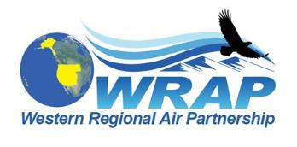
Regional Air Quality and the Regional Haze Rule
Information and resources for
Tribal professionals
Notes:
This presentation introduces the topic of regional haze and discusses what causes it, how it’s managed in a long-term improvement program by the Regional Haze Rule, and what you as a Tribal Nation can do to improve visibility and overall air quality for the benefit of both people and the environment.

Slide 2
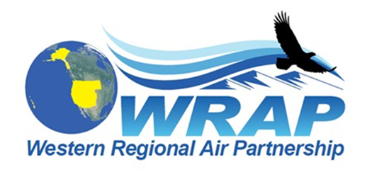
Tom Moore WRAP Air Quality Program Manager

Slide 3
Air quality and visibility basics
Clean, clear air is important to people from all cultures, worldwide
It is an important component of the sacred places in many cultural traditions
We appreciate the health benefits of breathing clean air
We also enjoy sweeping views in places with clear air, where we can “see for miles”
Polluted air is not only unhealthy to breathe, but can decrease visibility, making it difficult to engage in traditional cultural practices and diminishing those sweeping views
Notes:
Clean, clear air is a resource that has long been valued by people and cultures from around the world, not only for its health benefits and for the joy we feel when viewing an expansive landscape, but as an important component of the sacred places in many cultural traditions. The American West, in particular, has been cherished for the sweeping views of mountains, plains, mesas, and coastlines found across the region. Polluted air is not only unhealthy to breathe, but can also produce subtle to sometimes dramatic visibility impairments from regional haze, making it difficult to engage in traditional cultural practices or enjoy those sweeping views.

Slide 4
Visibility in the Clean Air Act
Clean Air Act
Main federal legislation to control air pollution
Controls a wide range of air pollutants from stationary and mobile sources
Primary focus on human and environmental health
Visibility also important
National Visibility Goal: “…the prevention of any future, and the remedying of any existing, impairment of visibility in mandatory class I Federal areas which impairment results from manmade air pollution”¹
Notes:
Visibility is considered important enough that a National Visibility Goal was included in the federal Clean Air Act, which is the primary federal legislation that controls air pollution through many different programs addressing emissions from stationary and mobile sources, hazardous air pollutants, acid rain, and others.

Slide 5
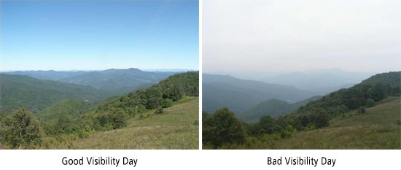
Regional haze
Certain types of air pollution form haze, which interacts with light and diminishes the quality of views across distance
Pollution that causes it often comes from far away: thus it is a regional problem
Can interfere with cultural practices for Tribal members, and impair enjoyment of special places, such as National Parks and Wilderness Areas
Notes:
Although local emissions sources can and do also significantly impair visibility, much of the pollution that causes haze often comes from far away and disperses across large areas. The Regional Haze program is focused on reducing regional emissions.

Slide 6
Additional concerns with regional haze
Also a sensitive indicator of other air quality problems
Same pollutants that cause haze can cause environmental and human health problems:
acidification of lakes and streams
depletion of soil nutrients
damage to culturally important plants, as well as sensitive forests and farm crops
aggravated asthma
respiratory problems such as irritation of the airways, coughing, or difficulty breathing
heart attacks
premature death in people with heart or lung disease
Notes:
Regional haze is a sensitive indicator of other air quality problems that may have effects far beyond visibility, as the same pollutants that cause haze (primarily fine particles) are linked to a host of other environmental and human health problems including those shown here.

Slide 7
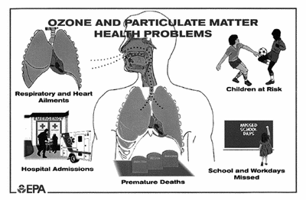
Environmental and health problems associated with haze
Notes:
Images show ozone damage to food crops, and the general effects of ozone and particulates on human health.

Slide 8
Processes that form haze
Notes:
Pollutants from a wide variety of natural and human-generated emissions sources are transported through the atmosphere by wind currents, where some are altered by chemical reactions and solar radiation. They can wind up in undeveloped places far away from the original sources, where they form haze and be deposited on the landscape, with the effects mentioned previously.

Slide 9
How haze impairs visibility
Notes:
Fine particles and certain gaseous compounds in the atmosphere can scatter and/or absorb light traveling from an object along a viewer’s sight path, as well as scattering light from other sources (clouds, the ground, etc.) into the sight path. The result is an overall reduction in the distance that can be seen, as well as a decreased ability to discern colors, forms, and textures of the object being viewed.

Slide 10
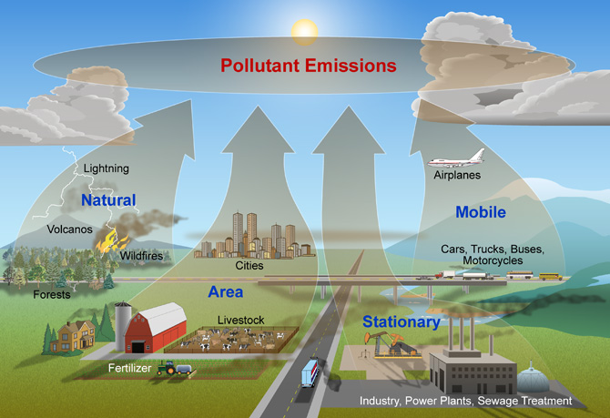
Pollutants that cause haze
Natural sources like wind-blown dust, wildfire smoke
Human-caused emissions including:
diesel soot
fly ash & sulfur
oxides from coal
burning
nitrogen oxides from
power plants and
automobiles
ammonia from farms
and feedlots
Transport of international emissions from other countries
Notes:
Both natural and human-caused sources release emissions that can produce haze, including the types shown here.

Slide 11
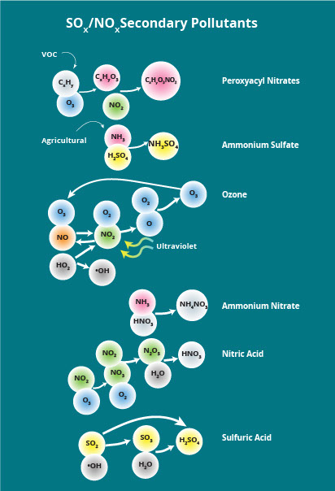
Pollutants that cause haze
Secondary pollutants formed
from reactions between
primary pollutants and natural
atmospheric components
including:
sulfates
nitrates
ozone
Notes:
Some of these pollutants also interact with each other or with natural components of the atmosphere to produce secondary pollutants such as sulfates, nitrates, and ozone, which also contribute to regional haze.

Slide 12
Haze pollutants can travel far!
Notes:
The pollutants that contribute to haze are small and light, and can travel hundreds or even thousands of miles from their original sources on wind currents, and be dispersed across large areas. Thus haze in a particular area can be the result of pollution originating nearby, or in a different state or country. This image, from September 3, 2017, shows smoke from fires in several Western states traveling hundreds of miles across adjacent states.

Slide 13
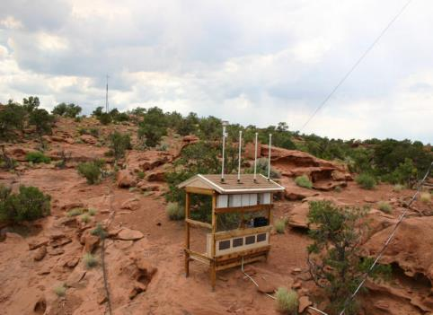
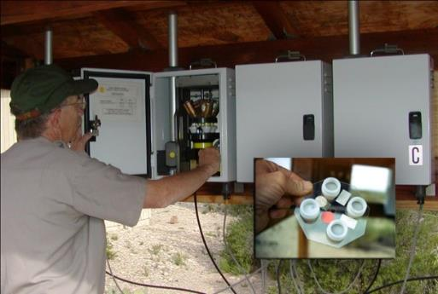
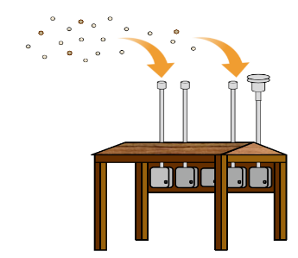
IMPROVE monitoring network
Interagency Monitoring of Protected Visual Environments (IMPROVE)
Monitor changes in haze pollutants over time
110 sites in federal Class I areas
48 additional monitoring sites in other areas follow IMPROVE protocol (including 8 on western Tribal lands)
Notes:
A network of monitoring stations (called the Interagency Monitoring of Protected Visual Environments or IMPROVE) was established to gather data on baseline visibility in representative federal Class I areas and track progress towards improving visibility as the Regional Haze Rule was implemented.
There are currently 110 IMPROVE sites in federal Class I areas around the country. EPA provides funding for these sites. Additionally, 48 IMPROVE protocol sites (following the IMPROVE data collection methods) are currently operating in other areas to complement the data collected at the IMPROVE sites.
Eight IMPROVE protocol sites are located on western Tribal lands, including the Flathead, Fort Peck, Makah, Northern Cheyenne, and Yurok Reservations; and the Knik, Ninilchik, and Sand Point Alaska Native Villages.

Slide 14
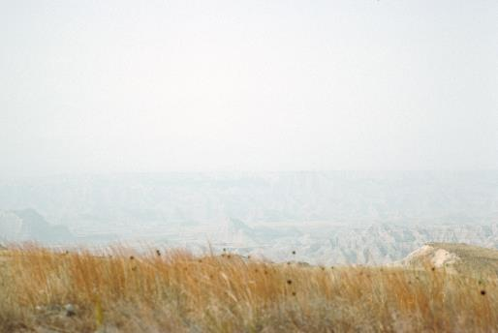
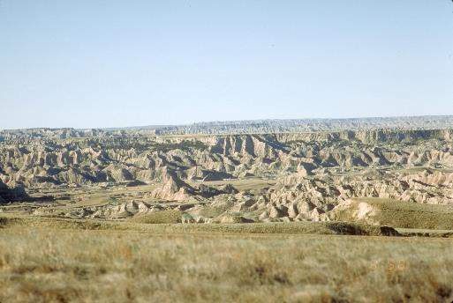
IMPROVE visibility photos
Repeat photographs taken from same locations at IMPROVE sites to document short- and long-term variation in visibility
Badlands National Park on a:
heavily impaired day minimally impaired day
Notes:
Note the big difference between the two photos taken from the same spot at the Badlands National Park IMPROVE site on a very hazy day and a very clear day.

Slide 15
IMPROVE and IMPROVE protocol sites
Notes:
Here are the IMPROVE and IMPROVE protocol site locations.

Slide 16
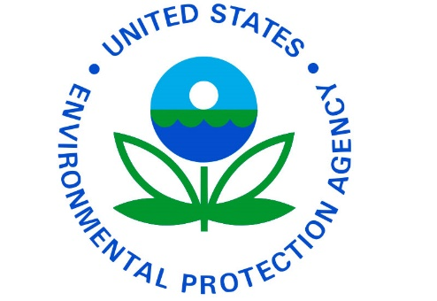
Laura McKelvey US EPA Office of Air Quality Planning & Standards

Slide 17
Regulation of regional haze
Clean Air Act amendments of 1977 set National Visibility Goal
Focus on mandatory federal Class I areas determined at that time (larger National Parks, Wilderness Areas, and Wildlife Refuges)
156 federal Class I areas across the country, over 75% are in in the West
Tribes can petition the EPA to designate their lands as Tribal Class I areas as well, and there are currently 5 designated Tribal Class I areas in the country
These areas have some Clean Air Act protections, but visibility provisions only apply to federal Class I areas
Notes:
The Clean Air Act amendments of 1977 set a national goal for remedying existing and preventing future impairment of visibility resulting from human actions in mandatory federal Class I areas, including larger National Parks and Wilderness Areas.
Tribes can also, if they choose to do so, petition the EPA to designate their lands as Class I areas under the Prevention of Significant Deterioration (PSD) program, to ensure that new or modified major sources take steps to avoid adverse impacts to air quality on Tribal lands . But the visibility provisions of the Clean Air Act do not apply to Tribal (or state) Class I areas.

Slide 18
Tribal Class I Areas
Notes:
Here are the five currently designated Tribal Class I Areas.
The Yavapai-Apache Nation in Arizona had their lands designated as a Class I area in the 1990s, but the designation was revoked by the courts because of problems with the way the EPA handled the designation. [note to reviewers that we’re waiting for confirmation from the EPA of the definitive current status of the area]

Slide 19
Federal Class I Areas
Notes:
These are the 156 Class I areas covered by the Regional Haze Rule most of them I areas are located in the West.

Slide 20
Regional Haze Rule
1990 amendments to Clean Air Act required study of how to improve visibility in Grand Canyon National Park and other Class I areas
Regional Haze Rule issued in 1999 to implement study recommendations
States must submit State Implementation Plans (SIPs) to control emissions contributing to regional haze
Tribes can also submit Tribal Implementation Plans (TIPs) to meet their specific needs, but these are optional
Notes:
The 1990 amendments to the CAA required the EPA to form a commission to study visibility in Grand Canyon National Park, and issue recommendations on how to improve visibility in this and other Class I areas on the Colorado Plateau. Following the release of the Grand Canyon Visibility Transport Commission’s report, the EPA issued the Regional Haze Rule in 1999.
Under the Rule, states are required to produce State Implementation Plans (SIPs) to demonstrate how they will control emissions that contribute to regional haze.
Tribes can also submit Tribal Implementation Plans (TIPs) if they choose, and can tailor them to address specific portions of the rule to meet the needs of the Tribe. TIPs are optional, however, and to date no Tribes have approved regional haze TIPs in place.

Slide 21
Regional Haze Rule
SIPs first submitted by 2010 for a planning period ending in 2018
To be revised and resubmitted in 2021 for the next planning period
Include reasonable progress goals (RPGs) for each Class I area in state (measured in deciviews):
one for most impaired days (to show improvement)
one for least impaired days (to show no degradation)
Notes:
The first Regional Haze SIPs were submitted over several years near the end of the 2000-10 decade for emissions reductions to be implemented by 2018. The next round (Round 2) of Regional Haze SIPs are due from all 50 states no later than July 31, 2021.
SIPs must include two reasonable progress goals (RPGs) for each Class I area within the state—one for the most impaired days, and one for the clearest days—for each planning period to show improvement in visibility on the most impaired days and no degradation of visibility on the clearest days. RPGs are expressed in deciviews, a measurement based on perceptible change to the human eye.

Slide 22
Current state of the Regional Haze Rule
EPA issued amendments to Rule in 2017 to address second planning period (2018 – 2028), including:
extension of SIP submittal deadline to 2021
strengthening consultation requirements to ensure issues raised early in planning process
several adjustments to progress report requirements
simplification of the Reasonably Attributable Visibility Impairment (RAVI) provisions of the Rule
EPA currently reviewing 2017 amendments, and intends to release revised planning guidance and analysis results in 2019
States working on modeling & analysis for 2021 SIPs
Notes:
In 2017 the EPA issued amendments to the Regional Haze Rule to address the second planning period (SIPs with 2028 reasonable progress goals). Revisions include those shown here. Note that the federal land manager consultation requirements are to ensure any issues that arise between states or Tribes and nearby federal lands are raised early in the planning process.
In 2018 the EPA declared its intent to revisit certain aspects of the 2017 amendments to streamline the compliance process and give more control to the states. The EPA is expected to release revised planning guidance and analysis results in 2019.
The WRAP and its member states are well into the modeling and analyses required to generate data for the Round 2 SIPs due in 2021.

Slide 23
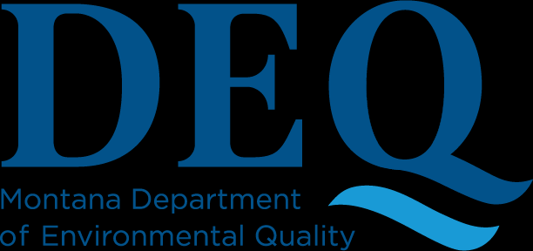
Rebecca Harbage Montana Department of Environmental Quality

Slide 24
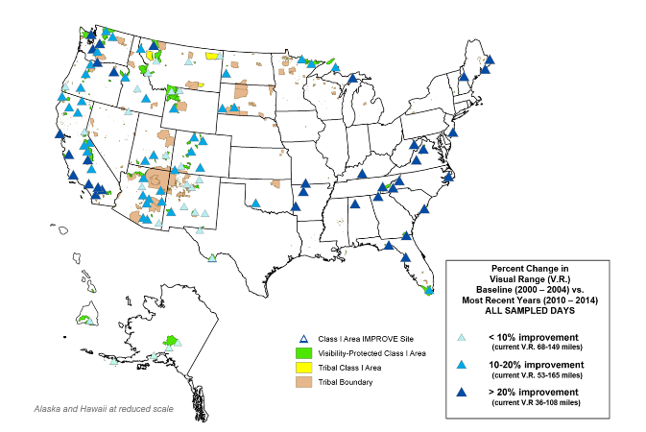
Results so far since implementation of the Regional Haze Rule
Emissions controls from first planning period reduced emissions of 500,000 tons/year of SO₂, and 300,000 tons/year of NO_{x}
Eastern Class I areas have
seen significant haze
reductions on worst days
Improvements in
western Class I areas
not as dramatic
Notes:
Considerable visibility improvements have been made in affected areas on the haziest days.
Eastern Class I areas have seen dramatic visibility improvements thanks to emissions reductions from implementation of the Regional Haze Rule, along with the Acid Rain Program and the Cross-state Air Pollution Rule (reference the figure, with darker blue triangles indicating more significant improvements in visibility) .
Western Class I areas have seen visibility improvements as well, but not as dramatically as in eastern states, primarily due to natural causes such as wildfires and dust storms, which can mask improvements due to human-caused emissions reductions.

Slide 25
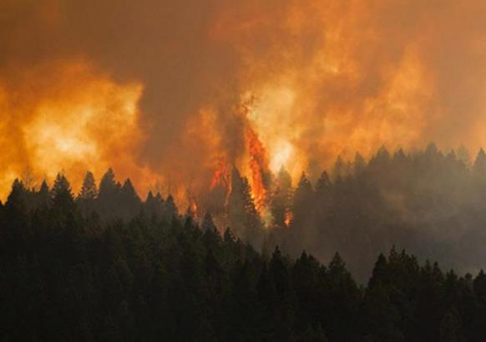
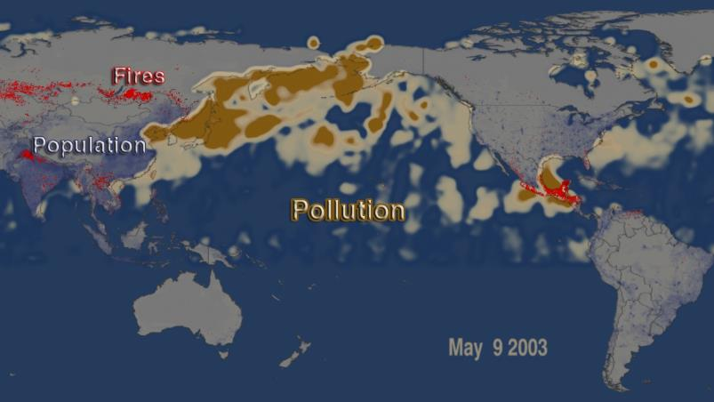
Complications for western states & Tribal lands
Notes:
The top two images show examples of the natural emissions sources that affect Western Class I areas, and can mask improvements in visibility due to reductions in human-caused emissions.
Note that international transport of pollutants can also have an affect on visibility in Western Class I areas, as seen in the lower image, showing pollution from fires and industrial sources in Asia moving across the Pacific Ocean to North America.

Slide 26
State Planning for the Second Implementation Period
(2018-2028)
States must assess visibility at each Class I area and answer the question:
We can answer the question through analysis of monitoring data & communication with partners and stakeholders including:
Are further emission reductions needed to ensure continued visibility progress over the next 10 years?
Tribes | EPA | Federal Land Managers | Industry Local Air Programs | Neighboring States
Formal Communication
Required in rule
Often not until the end of the planning process
Informal Communication
A very good idea
Occurs throughout the planning process
&
Notes:
We’ve made progress, but now what?
Previously mentioned that SIP revisions are due in 2021 for the second implementation period (2018-2028). States are in the process now of analyzing monitoring data to determine whether progress is being made at each Class I area. They are also looking at sources of emissions to assess whether additional emission controls might be necessary to continue to make progress.
Hopefully, states are also communicating with a wide variety of partners and stakeholders throughout the analysis process. Note the difference between the formal communication that is required in the Regional Haze Rule (fairly limited in scope and timing) versus the informal communication that should occur throughout the planning process in order to ensure all key parties are in the loop and have a chance to participate well before anything is finalized. This type of communication helps ensure a smooth process and ideally we arrive at the end with a plan that we already know will work for everyone.

Slide 27
State Planning for the Second Implementation Period
(2018-2028)
What sort of information can you expect to see during the planning process and in a draft or final SIP (or TIP)?
For each Class I area:
Calculations of baseline, current, and natural visibility conditions
Comparison of current visibility with:
baseline visibility (progress made to date)
natural visibility (progress still needed)
Long-term strategy to address visibility
Emission limits, compliance timelines, and any other measures necessary to make reasonable progress toward natural visibility
Reasonable progress goals for 2028
Notes:
Describe the sort of information involved in planning. These are topics that may be part of conversations between states writing SIPs or tribes writing TIPs and their partners and stakeholders.

Slide 28
Multi-jurisdictional Organizations (MJOs)
EPA encouraged States / Tribes to address visibility impairment from a regional perspective
Congress provided dedicated funding to regional organizations until 2010.
After 2010, the various Multi-Jurisdictional Organizations (MJOs) across the U.S. are now providing regional analysis and planning support
Participation in MJOs can help Tribes understand how the Regional Haze Rule is being implemented, and how compliance efforts may impact them
The organizations include:
Western States Air Resources Council-Western Regional Air Partnership
Central States Air Resource Agencies
Lake Michigan Air Directors Consortium
Metro 4-Southeastern States Air Resource Managers
Northeast States for Coordinated Air Use Management
Mid-Atlantic Regional Air Management Association

Slide 29
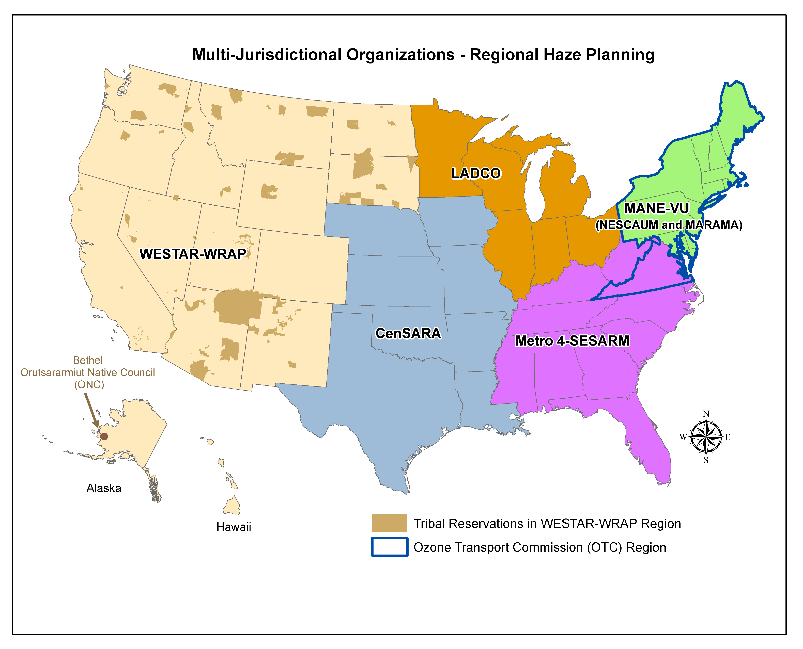
Notes:
EPA encouraged states and Tribes across the U.S. to address visibility impairment from a regional perspective and Congress provided substantial dedicated funding until 2010 to regional organizations.
After 2010, the various Multi-Jurisdictional Organizations (MJOs) across the U.S. are now providing regional analysis and planning support (see figure next page).
Participation in MJOs can help Tribes understand how the Regional Haze Rule is being implemented, and how compliance efforts may impact them.
(The organizations across the country include the Western States Air Resources Council-Western Regional Air Partnership, Central States Air Resource Agencies, Lake Michigan Air Directors Consortium, Metro 4-Southeastern States Air Resource Managers, Northeast States for Coordinated Air Use Management, and Mid-Atlantic Regional Air Management Association.)

Slide 30
For the western states & Tribes: Western Regional Air Partnership (WRAP)
Grew out of the committee assigned to study visibility in Grand Canyon National Park
Voluntary partnership of states, Tribes, local air agencies, federal land managers, and the EPA
Work together to:
address Regional Haze Rule planning & implementation
understand current and evolving regional air quality issues in addition to regional haze
provide input to EPA in modifications to existing regulations or development of new ones
Notes:
The Grand Canyon Visibility Transport Commission was later expanded to become the Western Regional Air Partnership, or WRAP. The WRAP works to address regional haze and other regional air quality issues in a coordinated manner, and provide a unified voice for Tribes and states in working with the EPA on air quality regulatory matters.

Slide 31
WRAP member support
Development and maintenance of regional databases for air quality emissions and monitoring data
Technical analyses and modeling for preparation of SIPs & TIPs
Training for member staff in compliance with Regional Haze Rule and other air quality regulations
Advocacy for member concerns in federal air quality regulatory actions
Notes:
Among many other things, the WRAP is currently working with member states to prepare SIPs for Round 2 of Regional Haze planning, providing training, modeling and analysis, and a standardized database storage system for emissions sources and model results to be incorporated into the SIPs.

Slide 32
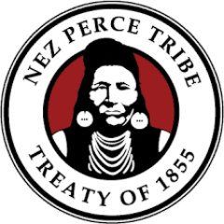
Julie Simpson Air Quality Program Coordinator Nez Perce Tribe

Slide 33
WRAP history: the first ten years

Slide 34
WRAP purpose and implementation
Primarily coordinate Western implementation of Regional Haze Rule
Broader mission to provide a venue for cooperatively addressing air quality issues of regional concern
Tribes and Tribal perspectives fully recognized and included in the WRAP from the beginning, setting a precedent for ways Tribes, states and federal agencies can collaborate to develop regional environmental policies
All Tribes in West automatically members
WRAP Board of Directors includes equal number of members from Tribes and states, along with federal government representatives, and is co-chaired by one Tribal and one state representative
Notes:
Tribes are automatically members in the WRAP, but need to send an official letter to WRAP requesting active membership and designating two contact people in order to be active members.

Slide 35
Tribal Caucus of the WRAP
This important group expressed concerns beyond regional haze. In 2009 these concerns were incorporated into WRAP charter:
research on the health impacts of particulate matter in rural communities;
dust modeling to improve Tribal and state emissions inventories;
research and coordination on climate change impacts and mitigation;
inclusion of increased emissions from oil and gas production in analyses for Regional Haze Rule compliance;
monitoring the effects of atmospheric mercury deposition;
technical assistance with other aspects of CAA compliance; and
modeling increased ozone emissions in rural areas.

Slide 36
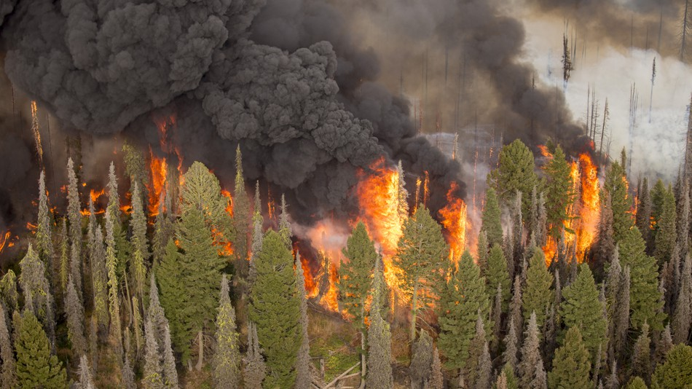
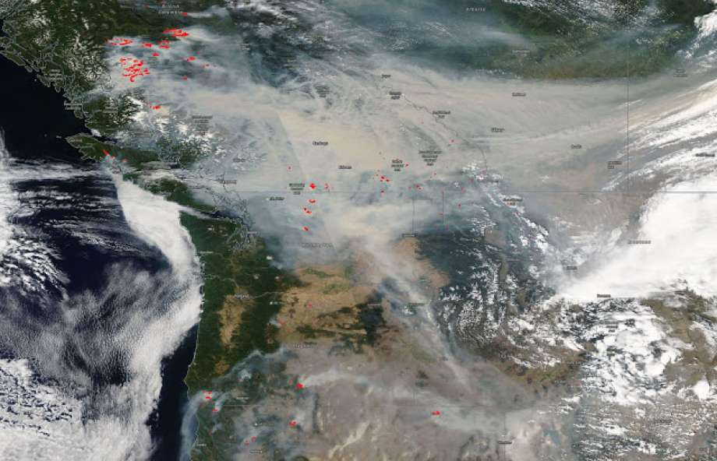
today

Slide 37
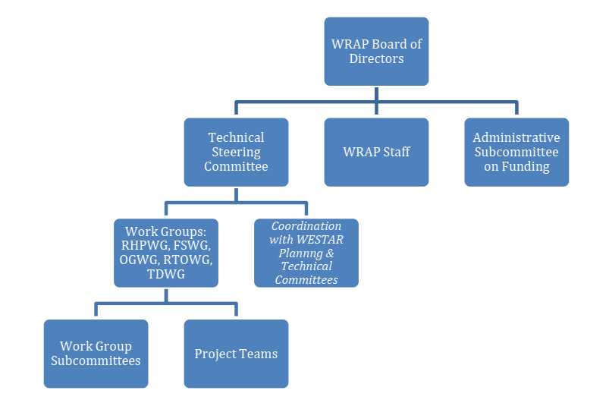
WRAP today
Continued voluntary partnership of Tribes, states, FLM, EPA
Many local air pollution control agencies participate
24 Tribes are active members of WRAP, participating in all WRAP sub-committees
In-person meetings
Decisions by consensus
BOD Co-chaired by Tribe
Equal Tribe and State BOD representation
Notes:
Tribes always have played an important role in WRAP governance. Needs and opportunities for more Tribal participation are growing.

Slide 38
Work groups focus effort on key challenges
Regional Haze Planning Work Group
Data collection, modeling, analysis
Fire & Smoke Work Group
Understanding fire’s role in air quality planning & improve coordination
Oil & Gas Work Group
Identify sites and improve data collection and research
Tribal Data Work Group
Training, funding opportunities, data collection support
Regional Technical Operations Work Group
Provides regional technical support for issues of common member interest
Notes:
These current WRAP’s sub-groups are of interest to different Tribes.

Slide 39
Tribal Data Work Group (https://www.wrapair2.org/tdwg.aspx)
The TDWG works to include Tribal issues / data in regional air quality planning and supports Tribal air quality program capacity / capability development. TDWG:
gathers data on size, complexity, and scope of Tribal air needs
supports Tribal membership and participation in the WRAP
supports Tribal air quality monitoring and emissions inventories
provides training opportunities
coordinates with the TSC and WRAP Work Groups to support Tribal needs

Slide 40
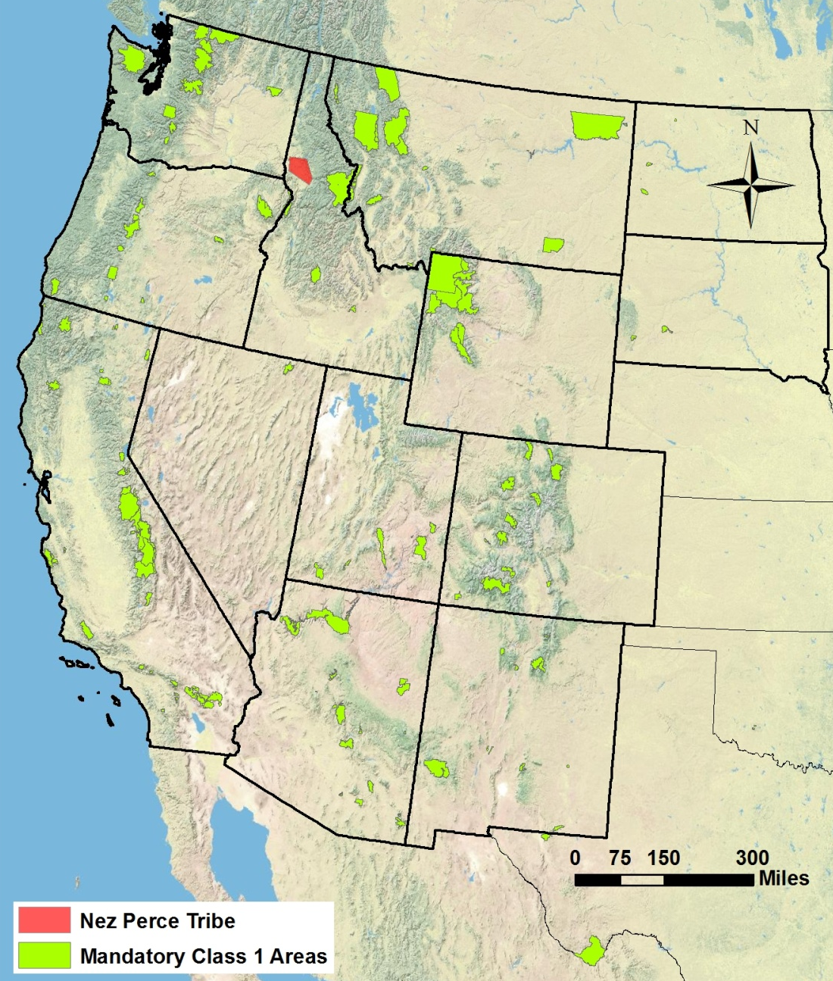
CASE STUDY Nez Perce Tribe

Slide 41
Case Study: Nez Perce Tribe
Involved in the WRAP since its inception (mid-90s)
The Nez Perce Tribe has Ceded lands and Usual and Accustomed Areas in what are now Class I areas
All lands are considered sacred – vistas and views are also considered sacred
Visibility-impairing and other air pollutants can impact ecosystems and human health
Networking with other Tribes, States, EPA, FLMs to accomplish shared goals in visibility, air quality protection, and protection of human health and welfare
The Nez Perce Tribe administers a smoke management and burn permit program under the EPA Federal Air Rules for Reservations (FARR - FIP)
Notes:
Ceded & U&A Lands & Class I Areas:
Selway-Bitterroot Wilderness Area
Hells Canyon Wilderness Area
Eagle Cap Wilderness Area
Treaty-reserved resources (hunting, gathering, fishing)
Visibility-impairing (ozone, acid rain, total PM) and other (nitrogen deposition and mercury methylation) pollutants can harm ecosystems and human health
Injure food and medicinal plants, and their ecosystem
Bioaccumulate deposition mercury and other metals into food- and medicinal- sources
Result in degradation of Petroglyphs, Petroforms, and other Sacred sites
Contribute to overall environmental degradation of Sacred sights
Trigger asthma and/or other respiratory conditions
Exacerbate cardiovascular conditions
Networking – invaluable opportunities for working with other air quality professionals with shared goals
SMP
There are a number of tools produced by the WRAP that are useful in smoke management (FETS, smoke emissions inventories)
Collaborative, multi-jurisdictional, regional approach to SMP is key to managing smoke and protecting human health and welfare
Smoke management has become a huge issue in recent years: prescribed burns, wildfires, smoke ready communities.

Slide 42
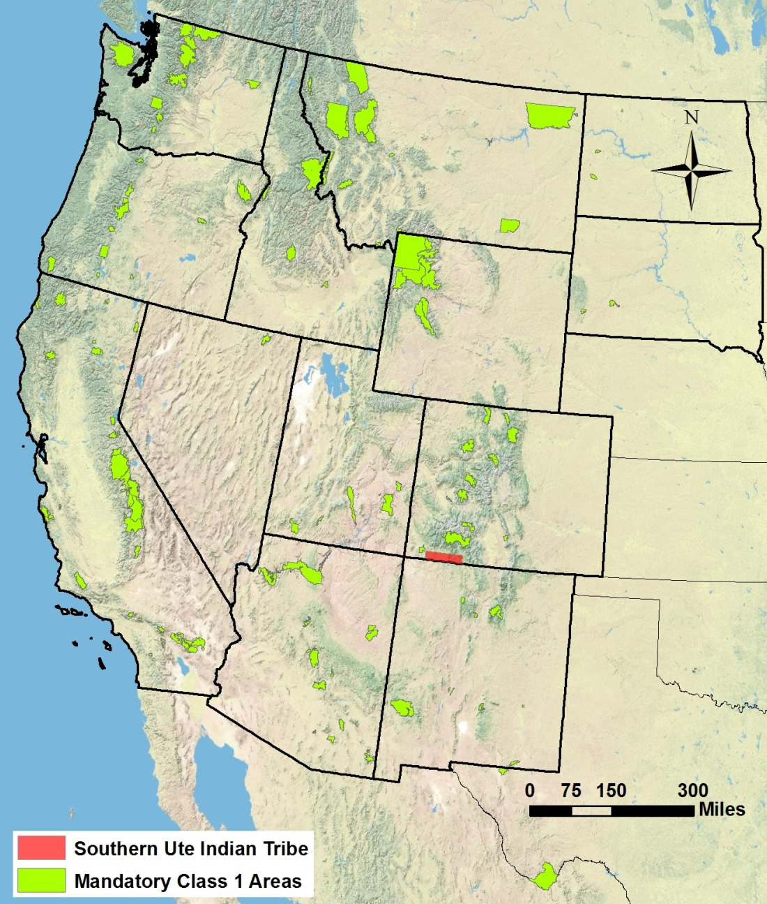
CASE STUDY Permitting In-house to Protect Public Health: Southern Ute Indian Tribe

Slide 43
Case Study: Southern Ute Indian Tribe
The Southern Ute Indian Tribe (SUIT) has significant oil & gas activity, both from SUIT-owned and non-Tribal companies.
Ozone concentrations on the Reservation have been close to non-attainment for ozone at one or more of its air monitoring stations for several years (e.g. 69ppb of 70ppb -- the national health-based standard).
SUIT’s Air Quality Program (AQP) manages some CAA implementation and enforcement, e.g. operating Title V permitting program.
SUIT currently under Federal Implementation Plan for Tribal Minor New Source Review (TMNSR) permitting for all oil & gas activity (over 6000 air pollution emissions sources on the Reservation)
Concern at AQP that the FIP and State of NM air quality regulations may not be adequate to prevent future non-attainment designation, due to volume of oil & gas activity, particularly if there is another boom.
AQP recommended assuming administrative responsibility for Federal TMNSR program and FIP – tasked to seek additional stakeholder input
Notes:
The SUIT AQP has worked to share emission inventory information with WRAP for their 2014 Greater San Juan Basin Emission Inventory and for their efforts in aiding the BLM in development of the Colorado Air Resource Management Modeling Study.
The Southern Ute Indian Reservation (SUIR) is a Reservation with significant natural gas production and the Southern Ute Indian Tribe (SUIT) owns and operates oil and gas production, processing and transmission companies on and off the Reservation. Ozone concentrations on the SUIR have been close to the 2015 Ozone standard of 70 ppb at one or more of its monitoring stations in one or more of the last several years. An Intergovernmental Agreement (IGA) is managed by the Southern Ute Indian Tribe and State of Colorado Environmental Commission (Commission), which serves as the policy-making and administrative review authority for the Reservation Air Program, and the IGA established the Tribe as the administrator of the Reservation Air Program. A main goal of the IGA was to create a single air quality program for all lands within the exterior Reservation boundaries. Under the IGA, the EPA retains authority to administer federal Clean Air Act programs on the Reservation that have not been adopted by the Commission. Since 2012, SUIT has been administering a Part 70 program delegation of the Title V Operating Permit program for the SUIR. This delegation provided the Tribe authority to perform permitting, compliance inspections, and civil enforcement. In 2018, 36 sources operated under SUIT-issued Title V permits.
According to the 2015 Southern Ute Indian Tribe Comprehensive Emission Inventory for Criteria Pollutants, Hazardous Air Pollutants, and Greenhouse Gases, oil and gas production and processing infrastructure account for the vast majority of stationary sources of air pollution on the Reservation. The Tribe manages two regulatory and one non-regulatory air quality monitoring stations on the SUIR. Pollutants monitored include ozone, oxides of nitrogen, carbon monoxide, particulate matter, sulfur dioxide, methane, and non-methane hydrocarbons. The Tribe also has an experimental mobile methane detection unit. Minor sources on the SUIR are currently regulated through the EPA’s administration of the federal TMNSR and FIP for all oil & gas activity (over 300 sources). There are approximately 2600 additional oil and gas sources on the SUIR with emissions below the de-minimus permitting thresholds of the TMNSR and FIP. There is concern at the Air Quality Program that the FIP and State of New Mexico air quality regulations may not be adequate to prevent a future non-attainment designation for Ozone in the San Juan Basin, due to the volume of oil & gas activity, particularly if there is another boom. The SUIT is considering either seeking administrative delegation for the TMNSR and FIP or submitting a TIP to replace the TMNSR and FIP in its entirety. The Air Quality Program recommended the Commission to consider authorizing the Tribe to seek administrative delegation of the federal TMNSR program and FIP at the Commission meeting on December 5, 2018. The Commission has tasked the Air Quality Program with seeking some additional stakeholder input prior to making a final decision on minor source regulation on the SUIR.

Slide 44
CASE STUDY Forestry, Fire and Air Quality: Confederated Tribes of the Colville Reservation

Slide 45
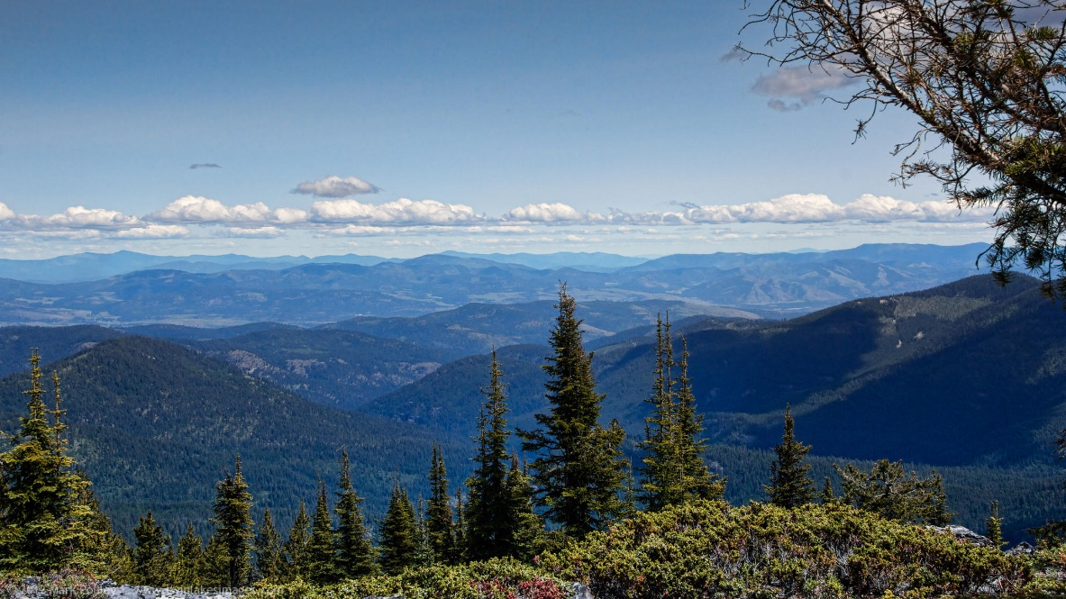
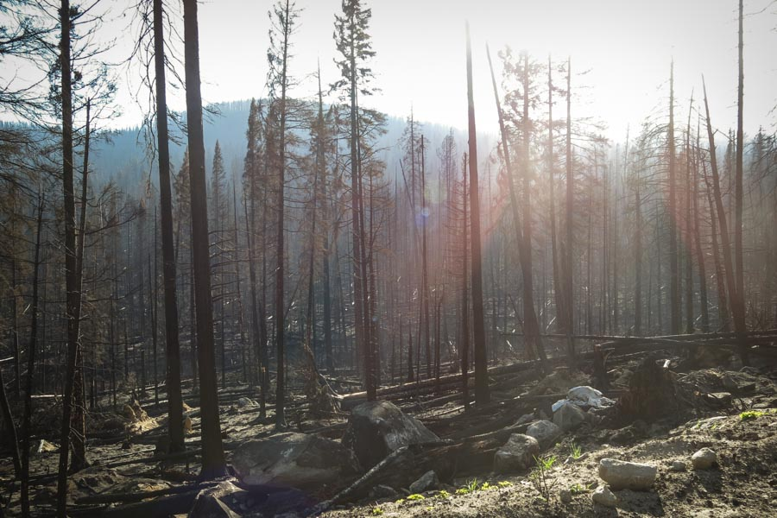
CASE STUDY: Confederated Tribes of Colville Reservation
Forestry = significant revenue for Tribal government and economic benefits for Tribal members
Devastating 2015 wildfires burned 20% of Tribal land
Timber valued at $100 Million
Increased fire season and winter inversion = air quality health concerns
Notes:
Forestry, Fire and Air Quality: Confederated Tribes of the Colville Reservation
For the Confederated Tribes of the Colville Reservation ("Colville Tribes"), who have been long-time active participants in the WRAP, forest management and timber sales are an important source of revenue. These revenues have historically funded Tribal government operations, providing services and supporting government employment. About two thirds of the reservation is forested; the wildfires in the 2015 season burned nearly 20 percent of the Tribe’s total land, including timber valued at $100 million. Increasingly severe fire seasons and a tendency for winter weather inversions also cause serious air quality health concerns. Consequently, managing fires for forest health and public health is important to the Tribes. The Colville Tribes’ Forestry division collaborates with the Air Quality program in the Office of Environmental Trust and other Tribal agencies to plan for and manage fire as part of its strategies in implementing its role in the Integrated Resources Master Plan and the Forest Management Plan.
In Fall 2015, the Confederated Tribes of the Colville Indian Reservation signed an agreement with USEPA Region 10 to allow the Tribes to manage the Federal Air Rules for Reservations provisions for air pollution episodes, open burning and burn bans. This partial delegation of authority under FARR enabled much greater outreach regarding these provisions, as they are now managed by the Colville Reservation Office of Environmental Trust. Enforcement remains the responsibility of EPA Region 10.
The Air Quality Program of the Office of Environmental Trust monitors air quality on the Reservation, makes determinations about appropriate burning times and burn bans, and issues permits for agricultural and other field or open burning. As part of this work, the Air Quality Program is involved with other Tribal programs, such as Emergency Services, Colville Indian Housing Authority, and Tribal Health, and collaborates with regional agencies on smoke and other air pollution issues and monitoring.
The Colville Tribes at this point have been long-time active members of the WRAP. Many years ago, Kris Ray, the Tribes’ Air Quality Program manager, noticed a high haze over the Reservation that could not be attributed to local or regional emissions sources. He looked into WRAP for guidance, and became an active member by joining the Technical Steering Committee and becoming co-chair of the Tribal Data Workgroup. This involvement has helped him understand the complexities of Regional Haze and other Western and national U.S. air quality issues.

Slide 46
Randy Ashley Air Quality Program Manager Confederated Salish and Kootenai Tribes Tribal Co-Chair, WRAP Board of Directors

Slide 47
CASE STUDY A Legacy of Involvement in the Regional Haze Process Confederated Salish and Kootenai Tribes of the Flathead Nation

Slide 48
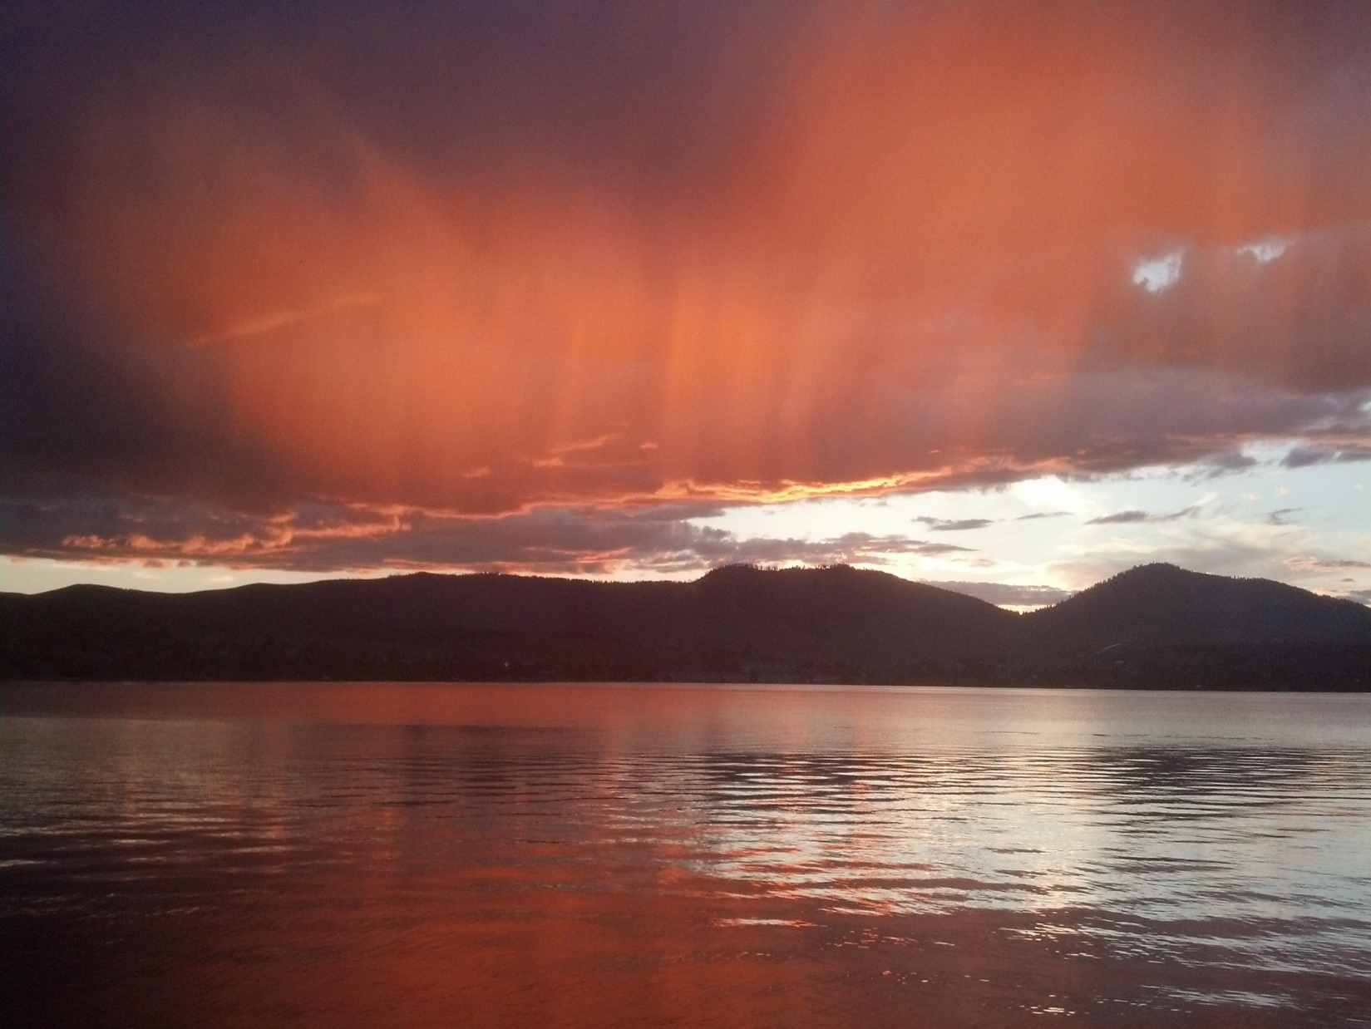
Notes:
The Confederated Salish & Kootenai Tribes are one of the original tribes to redesignate their air shed as Class 1 (1979-1981). As such their interest and involvement in Regional Haze began during the Grand Canyon Transport Commission and migrated to the Western Regional Air Partnership. On August 7, 1987, EPA designated Polson and Ronan a Group I (Non-Attainment) area for PM based on the Total Suspended Particulate (TSP) data collected by the CS&KT Air Quality Program from 1982-1986. Designation as a Group I area simply means that according to the data collected in Ronan and Polson from PM₁₀ and TSP monitors those communities were expected to exceed the EPA standards of 150 µg/m³ daily or 50 µg/m³ annual average.
Improve Monitoring
This site was established on June 4, 2002 for Interagency Monitoring of Protected Visual Environments. The data for the IMPROVE network is obtained from a download off of the Colorado State website. The Regional Haze Rule expressly provides that tribal visibility programs are “not dependent on the strategies selected by the state or states in which the tribe is located”
CSKT has participated in the WRAP since it’s inception. Lewis McLeod and I felt that tribes were very fortunate to have had the opportunity to be in the company of highly experienced air quality professionals and that his friendship increased the capacity of tribal air programs and our ability to provide input into state actions that benefit both the states and tribes.
Examples of products:
Tribal Set Aside (Market Trading Forum)
TEISS
Model TIP
Tribal Protocol, Regional Haze Tip Development
Section 309 Tribal Guidance Document
Tribal Renewables Report

Slide 49
Case Study: Confederated Salish and Kootenai Tribes of the Flathead Nation
CSKT – Class 1 and non-attainment PM10
IMPROVE monitoring
Wrap participation and benefits
Examples of products
Notes:
The Confederated Salish & Kootenai Tribes are one of the original tribes to redesignate their air shed as Class 1 (1979-1981). As such their interest and involvement in Regional Haze began during the Grand Canyon Transport Commission and migrated to the Western Regional Air Partnership. On August 7, 1987, EPA designated Polson and Ronan a Group I (Non-Attainment) area for PM based on the Total Suspended Particulate (TSP) data collected by the CS&KT Air Quality Program from 1982-1986. Designation as a Group I area simply means that according to the data collected in Ronan and Polson from PM₁₀ and TSP monitors those communities were expected to exceed the EPA standards of 150 µg/m³ daily or 50 µg/m³ annual average.
Improve Monitoring
This site was established on June 4, 2002 for Interagency Monitoring of Protected Visual Environments. The data for the IMPROVE network is obtained from a download off of the Colorado State website. The Regional Haze Rule expressly provides that tribal visibility programs are “not dependent on the strategies selected by the state or states in which the tribe is located”
CSKT has participated in the WRAP since it’s inception. Lewis McLeod and I felt that tribes were very fortunate to have had the opportunity to be in the company of highly experienced air quality professionals and that his friendship increased the capacity of tribal air programs and our ability to provide input into state actions that benefit both the states and tribes.
Examples of products:
Tribal Set Aside (Market Trading Forum)
TEISS
Model TIP
Tribal Protocol, Regional Haze Tip Development
Section 309 Tribal Guidance Document
Tribal Renewables Report

Slide 50
Tribal engagement in WRAP It’s Important

Slide 51
Benefits for Tribes of participation in the process
WRAP membership open to any Tribes in the region who wish to participate
Stay informed of latest air quality regulations
Give input into regulations as they’re developed, to have a say in regulations that will affect Tribal lands
Increase awareness among states of Tribes as governmental & regulatory agencies
Access to technical resources such as air quality models, databases, special studies, and training opportunities
Familiarity with partnering state SIP planners and SIP components
Opportunities for Tribal staff to build professional networks with federal, industry and environmental colleagues
Notes:
Tribes can benefit greatly from participation in the air quality and regional haze regulatory process. Joining the WRAP offers many opportunities to stay informed and give input to regulations as they’re developed or implemented. Since Tribes may not have the capacity to review all proposed regulations, participation in the WRAP provides access to summaries of the regulations, and an easy means to have a Tribal perspective added to the WRAP’s comments to the EPA. Participation also strengthens awareness among neighboring states and local governments of Tribal sovereignty, and of requirements for consultation when reviewing projects near Tribal lands. WRAP membership also offers training in various aspects of regulatory compliance, and opportunities for Tribal professionals to form connections with colleagues in government and industry.

Slide 52
Tribal membership in WRAP
24 Tribes are active members today
All Tribes are automatically members; any Tribe in the region can take an active part in the WRAP
Tribes must submit a request letter to WRAP and designate two representatives in order to become an “active” member
Membership commitments can include: regular meetings of sub-committees, participation in workshops, review of technical documents, and time spent working on ideas and solutions
For face-to-face meetings, some travel costs are covered and some are Tribal responsibility
Notes:
To become active members, Tribes need to contact WRAP in writing and request this, and designate two people as points of contact

Slide 53
WRAP Tribal Resources
Fact sheets:
Tribes, WRAP and the Regional Haze Rule: Practices and Processes for Tribes to Address Regional Air Quality
Regional Air Quality and the Regional Haze Rule: Information and Resources for Tribal Professionals

Slide 54
For more information on WRAP membership:
www.wrapair2.org

